Slide 1


Hospital Operations and Patient Outcomes Analysis
Optimizing Admissions, Room Availability, and Patient Care through Data Analysis
By Anthony ofordum

Slide 2

Table of Contents
Project overview
Problem Statement
Dataset Overview
Data Workflow
Methodology
Data Insights
Conclusion
Recommendations

Slide 3

Project Overview
Purpose: the objective of this project is to analyse hospital admissions, room availability, and patient outcomes to provide actionable insights for improving hospital operations.
Tools used: Excel (Power Pivot, Power Query, Pivot Table, DAX), data analysis techniques, and visualization tools.

Slide 4

Problem Statement
Hospitals need to optimize resources, reduce patient stay durations, and improve patient satisfaction without compromising care quality.
Here are the 5 business questions we will address:
Which age group has the most trauma, emergency, and urgent cases?
How do admissions and available rooms compare across wards?
How does illness severity affect the length of stay?
Which ward type has the longest and shortest average stay?
Which department handles the most critical patients?

Slide 5
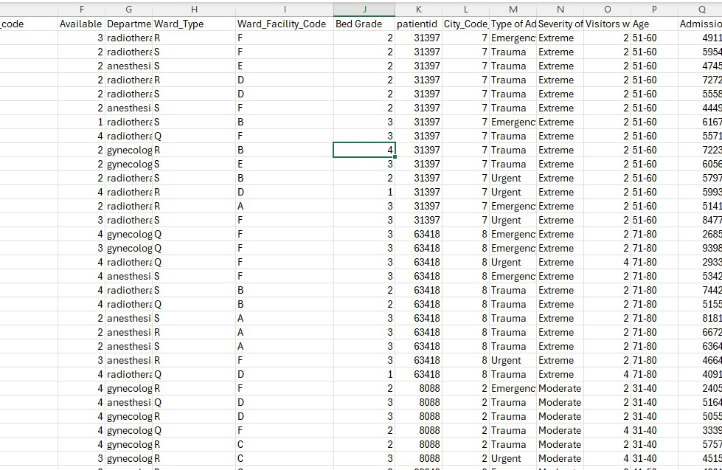
Dataset Overview
This dataset includes patient admissions data across different departments, including room availability, patient age, type of admission (emergency, trauma, urgent), illness severity, and stay duration.
Key columns: department, type of admission, severity, room availability, stay duration, etc.
Link to dataset: https://drive.google.com/file/d/1fWTi0EG054PHhq-TqbeVypKpC-5TBUvW/view?usp=drive_link
Notes:
The dataset used in this analysis has been anonymized to protect patient privacy and does not contain any personally identifiable information (PII).

Slide 6



Data Workflow
Data Collection and Preparation
Data Analysis
Dashboard Creation

Slide 7
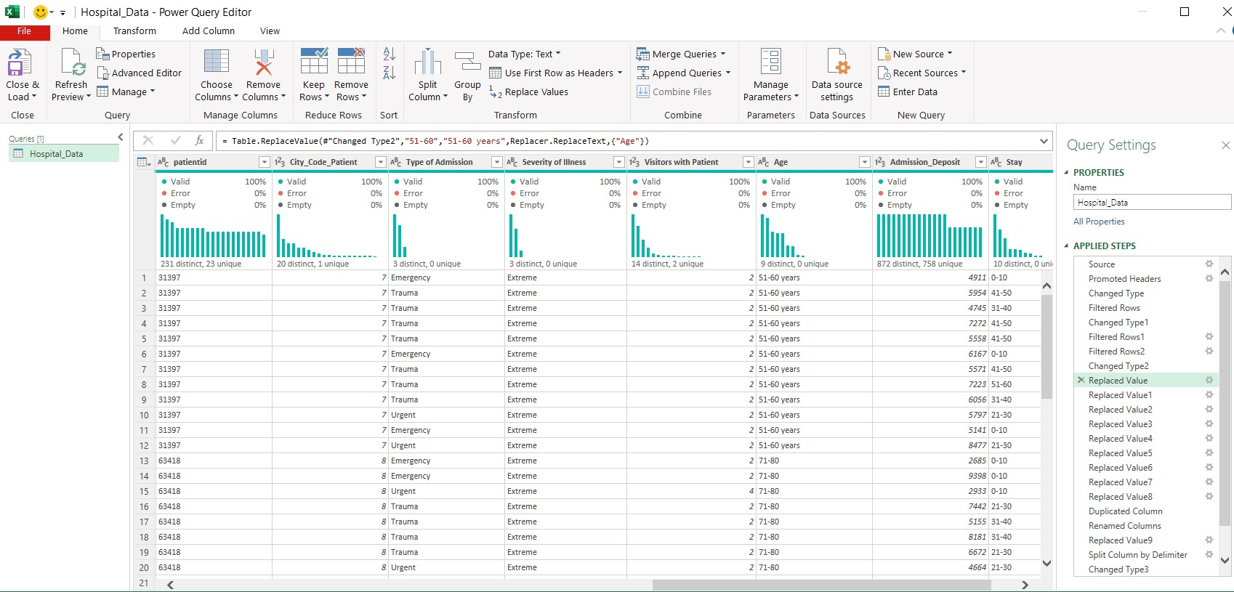
Methodology
Data Cleaning:
Converted columns to text format: I changed the data type of the columns case_id, hospital_code, and city_code_hospital to text.
I also changed the data type of the columns patientid and bed grade to text.
Replaced age range values:
I replaced the value "51-60" with "51-60 years" in the age column to make the data more descriptive.

Slide 8
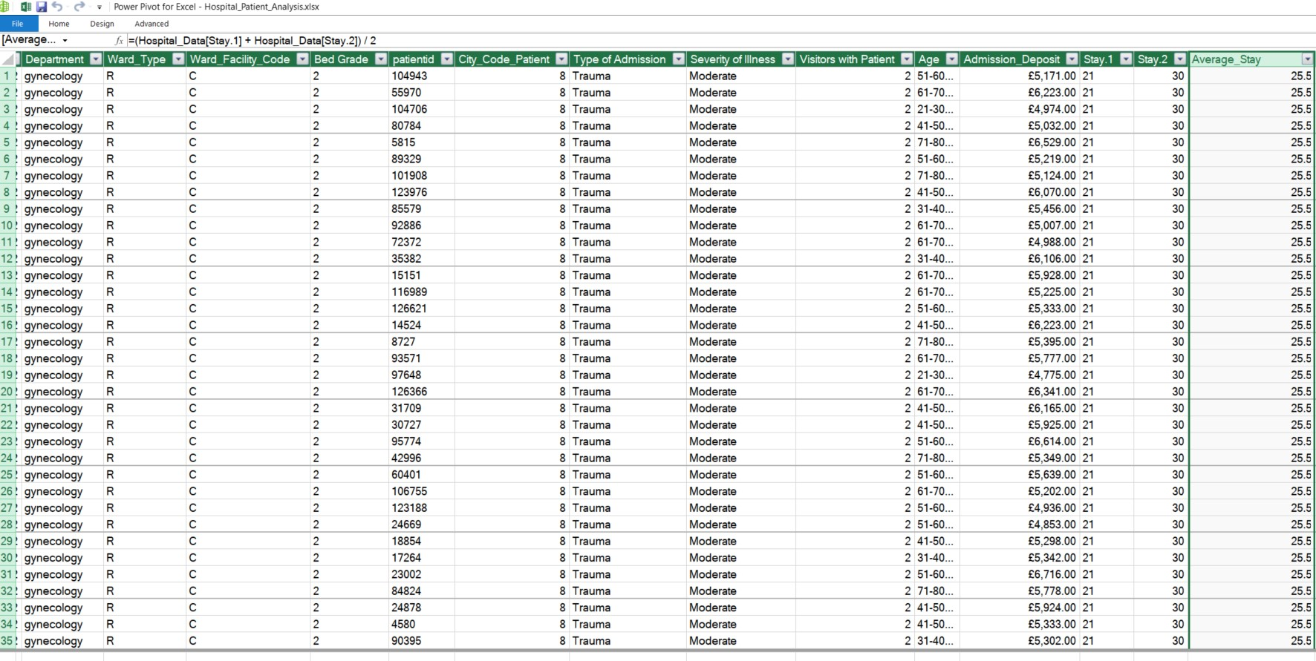
Methodology
Split the 'Stay' column into two parts:
I split the Stay column into two new columns: Stay.1 (the lower bound) and Stay.2 (the upper bound) based on the hyphen delimiter, preparing the data for further manipulation or calculation.
Calculated the midpoint of stay ranges:
I created a new column to calculate the midpoint of the stay duration by using the formula:
=(Hospital_Data[Stay.1] + Hospital_Data[Stay.2]) / 2

Slide 9
Key DAX Measures Used in Analysis:
Total admissions = COUNTROWS(Hospital_Data)
Emergency Patients = CALCULATE(COUNTROWS(Hospital_Data), Hospital_Data[Type of Admission] = "Emergency")
Trauma Patients = CALCULATE(COUNTROWS(Hospital_Data), Hospital_Data[Type of Admission] = "Trauma")
Urgent Patients = CALCULATE(COUNTROWS(Hospital_Data), Hospital_Data[Type of Admission] = "Urgent")
AVERAGE([Average_Stay])

Slide 10
Gynecology handles over 45,000 trauma and 40,000 emergency cases—consider allocating more resources to this department to manage the high volume of critical cases.

Slide 11
Trauma cases peak at over 25,000 in the 41-50 age group, while emergency cases are also highest in the 41-50 age group with 16,875 admissions—focus on trauma prevention and emergency preparedness for these age groups (31-60).

Slide 12
Patients with extreme trauma have the longest average stay at 41 days, while emergency and urgent cases average 38 days—consider process improvements to reduce stays for extreme trauma cases.

Slide 13
Ward S has the longest average stay at 43 days, while Ward U has the shortest at 25 days—explore applying Ward U's efficiency strategies to reduce stay durations in Ward S.

Slide 14
Ward R has 90,538 admissions and 3 extra rooms, while Ward P has 3,376 admissions with the most extra rooms (5). Ward U shows the lowest admissions with 3 extra rooms—consider reallocating resources from Ward U to busier wards like R

Slide 15
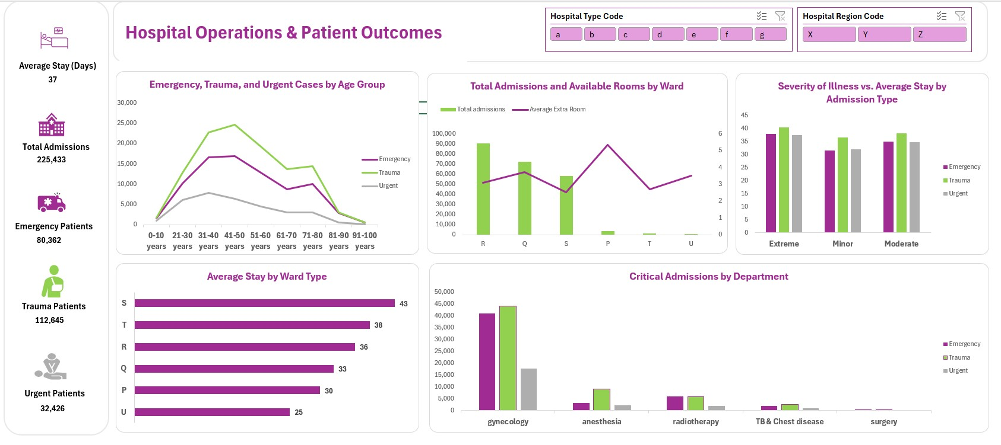

Slide 16

Conclusion
The hospital faces significant demand for trauma and emergency care, particularly in gynecology and for patients aged 31-60 years.
Ward S has the longest average stay at 43 days, while Ward U has the shortest at 25 days. However, Ward U also has next to low admissions, indicating lower patient volumes or less critical cases.

Slide 17
Recommendations
Redistribute resources: Reallocate additional rooms and staff to high-demand wards like R and S, while reviewing the resource usage in Ward U with its lower admissions.
Preventive initiatives: Focus on trauma prevention programs for the 31-40 age group and improve emergency care readiness for the 51-60 age group.
Optimize ward efficiency: Investigate why Ward S has longer stays and apply best practices from Ward U to reduce stay durations. Assess if Ward U’s lower admissions indicate underutilized resources.
Support critical departments: Allocate more resources to gynecology to manage the large number of trauma and emergency cases effectively.

Slide 18
THANK YOU

